Slide 1
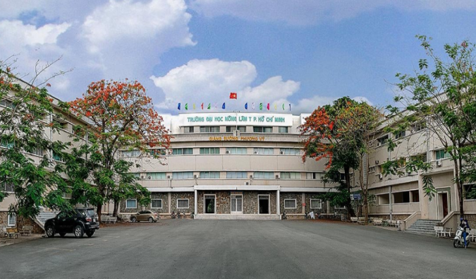
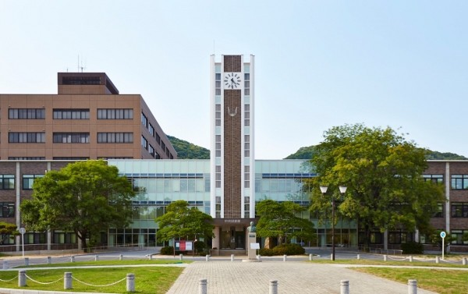
Summer Course «Bio-tech Applications in Animal Science and Sustainable Livestock»
NONG LAM UNIVERSITY - HO CHI MINH CITY
FACULTY OF ANIMAL SCIENCE AND VETERINARY MEDICINE
REGISTRATION
WHO CAN APPLY?
Candidates are students at least in 3rd year, postgraduate students, young lecturers and international students who have studied at Nong Lam University or are studying at different universities which are partners with Nong Lam University or Okayama University. Successful candidates are expected to have a background in animal science, veterinary science or biotechnology.
HOW TO APPLY?
Application documents: should be scanned and emailed to the organizing secretary via email provided below, include: 1 - Application form;
- Academic transcript (for students) or copy of degree (for young lecturers)
- English language certificate.
Deadline: Application are opened untill 20th Feb 2019
No registration fee
For further information, please contact the organizing committee at: +84 911 789 027 or mi.buithitra@hcmuaf.edu.vn
Website:
In 1955, the BLAO National College of Agriculture was established at Bao Loc, Lam Dong province which set up the milestones for developing present Nong Lam University (NLU). Throughout its 64 years’ history, NLU has been playing an important role in education, extension, dissemination of scientific technologies in Vietnam with its pursuit of academic excellence and commitment to country innovation and creativity. Its vision is to become an Asian leading multi-disciplinary research university with international standards.
Faculty of Animal Science and Veterinary Medicine was established in 1955. Through 64 years of operation, the Faculty has trained thousands of veterinarians and B.S in animal science and in both regular and work-study systems, as well as many masters and Ph. Ds, who currently working in institutes, universities, state agencies, enterprises, manufacturing companies, farms throughout the country. Since 2010, the Faculty has been in collaboration with the School of Veterinary Medicine, University of Queensland, Australia to train the veterinary students under the advanced program.
This course will be jointly organized by Okayama University and Nong Lam University Hochiminh city during 11 – 19 March 2019 at the Faculty of Animal Science and Veterinary Medicine - Nong Lam University, Ho Chi Minh City, Vietnam. Participants will befenit from not only provided knowledge on bio-tech applications in animal science and sustainable livestock, laboratory exercise and fieldtrip to Lam Dong province, but also networking with other people with similar academic interests.
It will be an outstanding opportunity for participants to experience Japanese knowledge and skills. The subjects will be given by lecturers and professors from both Okayama University and Faculty of Animal Science and Veterinary Medicine - Nong Lam University in English.
Okayama University
In Chugoku Region, Okayama Perfecture, Okayama University is one
of Japan leading university with over 140 years of history. It is situated on an extensive campus and has 11 faculties, 7 graduate schools providing undergraduate and postgraduate training for currently 20,000 students in humanities, social, natural, environmental and life sciences, and pedagogics. It has 11 faculties, 7 graduate schools and various.
The university has achieved Japanese education rewards such as Excellence in Research, Excellence in Education, Affordable Campus Life, Safe and Convenient, Friendly and Welcoming.
The 6th International
Summer Course
11 – 19 March 2019
NONG LAM UNIVERSITY - HO CHI MINH CITY
FACULTY OF ANIMAL SCIENCE AND VETERINARY MEDICINE Room 216, Phuong Vy Building – Nong Lam University Linh Trung Ward, Thu Duc District, Ho Chi Minh City, Vietnam
Tel: (+84) 028 3896 1711
Email: kcnty@hcmuaf.edu.vn
Website: https://vet.nlu.edu.vn/

